Slide 1
DATA ANALYTICS PROJECT
Retail Sales Analytics
Capstone Project
Excel
MySQL
Python
Power BI
Prepared by: Prasanna Balaji M
Domain: Retail, Sales & Inventory Analytics

Slide 2






Project Objectives
What this capstone sets out to achieve, end to end
Clean & Prepare Data
Relational Structure
Sales Performance
Clean and prepare retail transaction data for analysis.
Build a relational structure for joins, aggregations and business queries.
Analyze sales performance across stores, products, customers and staff.
Customer Behavior
Inventory Monitoring
Interactive Dashboard
Understand purchase behavior to support customer segmentation.
Monitor stock levels and identify low-stock products.
Build an interactive Power BI dashboard for management reporting.
RETAIL SALES ANALYTICS | CAPSTONE PROJECT
2

Slide 3




Project Methodology
A four-phase pipeline, from raw data to a management-ready dashboard
01
02
03
04
PHASE 1 · EXCEL
PHASE 2 · MYMySQL
PHASE 3 · PYTHON
PHASE 4 · POWER BI
Data Cleaning
Storage
Exploratory Analysis
Visualization
and Preparation
and Querying
and Segmentation
and Dashboard
RETAIL SALES ANALYTICS | CAPSTONE PROJECT
3

Slide 4

Phase 1 — Excel
Data Cleaning and Preparation
Standardized column names and formats across customer, order and product-related tables.
Created derived sales fields such as total price.
Identified duplicate records and checked missing values.
Used lookup operations to combine related product information where required.
PHASE 1
Converted date and numeric fields into appropriate formats.
Used pivot-table summaries and filters for initial validation and outlier checking.
Excel
Validated categorical values such as order status.
RETAIL SALES ANALYTICS | CAPSTONE PROJECT
4

Slide 5
Phase 2 — MyMySQL
Storage and Querying
Loaded cleaned Excel/CSV data into the MySQL salesdb database.
Created relationships between tables using primary and foreign keys in salesdb.
Used joins across orders, order_items and products for transaction analysis.
Aggregated sales by store and staff and identified top-selling products.
PHASE 2
MySQL
Summarized customer purchases using orders, items and revenue.
Identified products below the low-stock quantity.
RETAIL SALES ANALYTICS | CAPSTONE PROJECT
5

Slide 6
Phase 3 — Python
Exploratory Analysis and Segmentation
Loaded relational data into Python for exploratory analysis.
Used descriptive analysis and visualizations to understand the dataset.
Calculated customer RFM features: Recency, Frequency and Monetary value.
PHASE 3
Python
Used RFM features to create customer segments such as At Risk, Champions and Loyal Customers.
Used the customer_segments table in the Power BI reporting workflow.
RETAIL SALES ANALYTICS | CAPSTONE PROJECT
6

Slide 7
Phase 4 — Power BI
Visualization and Dashboard
Imported tables from MySQL using Get Data.
Created KPI cards and interactive visuals for sales, products, inventory, staff and customers.
Added slicers and filters for interactive exploration.
PHASE 4
Power BI
Created a consolidated reporting experience with management-focused sections.
Included customer-segment distribution, segment revenue and interactive segment filtering.
RETAIL SALES ANALYTICS | CAPSTONE PROJECT
7

Slide 8
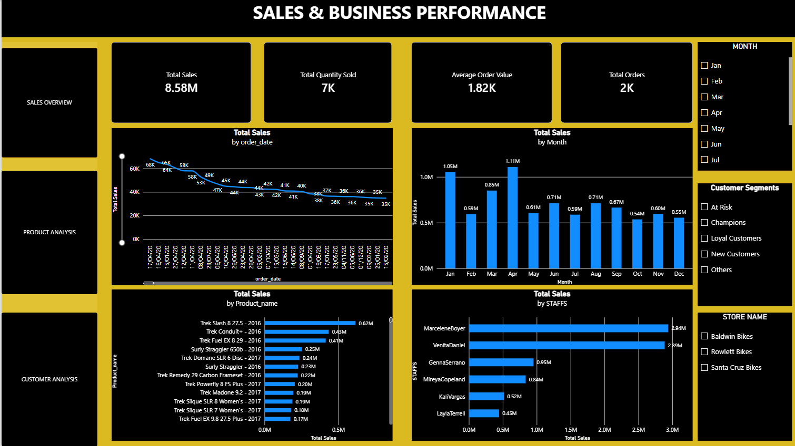
POWER BI • SALES PERFORMANCE
8.58M sales • 7K units • 2K orders • 1.82K average order value

Slide 9
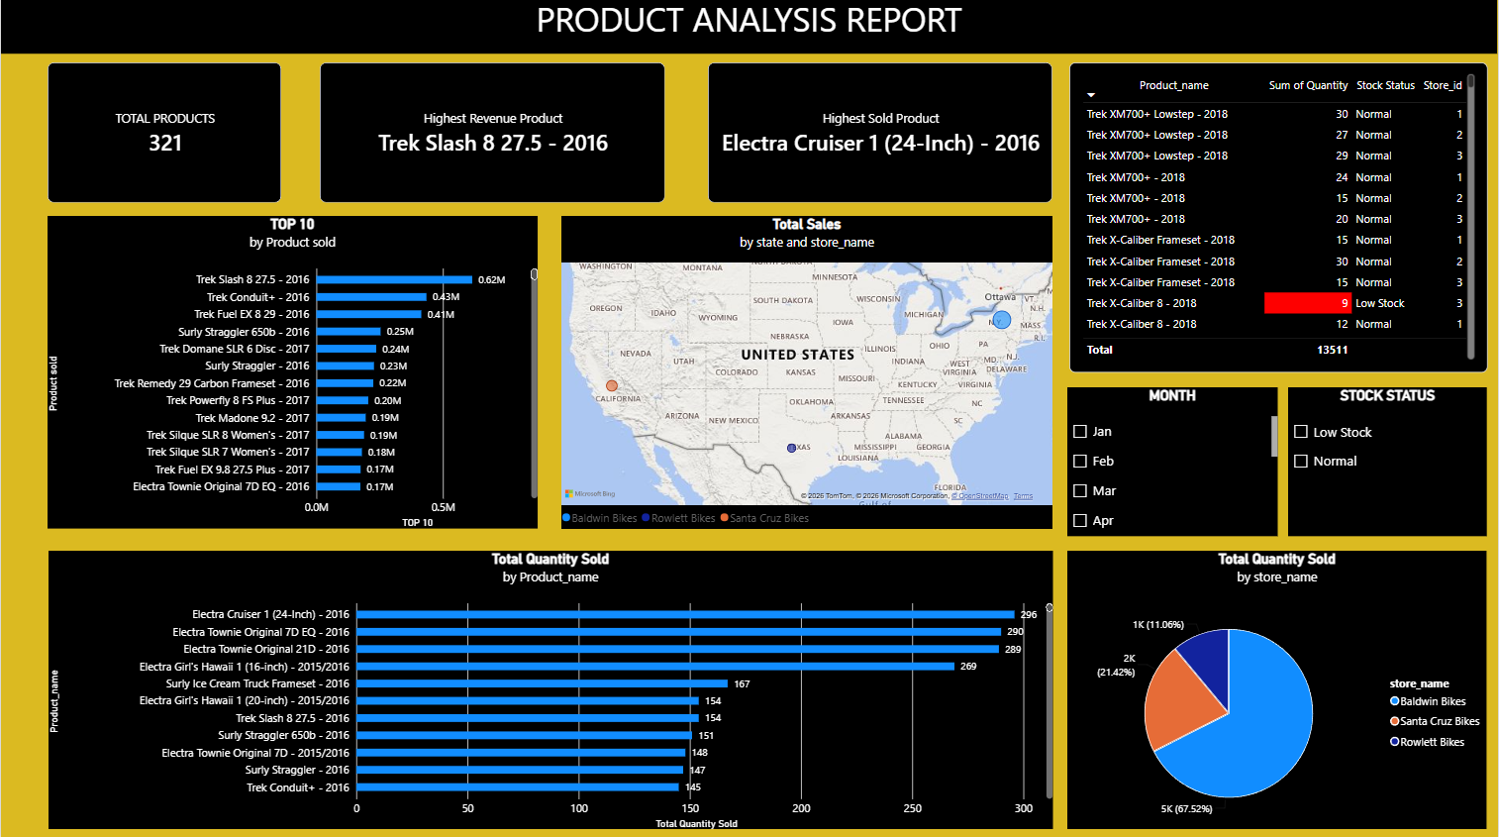
POWER BI • PRODUCT & INVENTORY ANALYSIS
Top products • store revenue • quantity by store • low-stock status

Slide 10
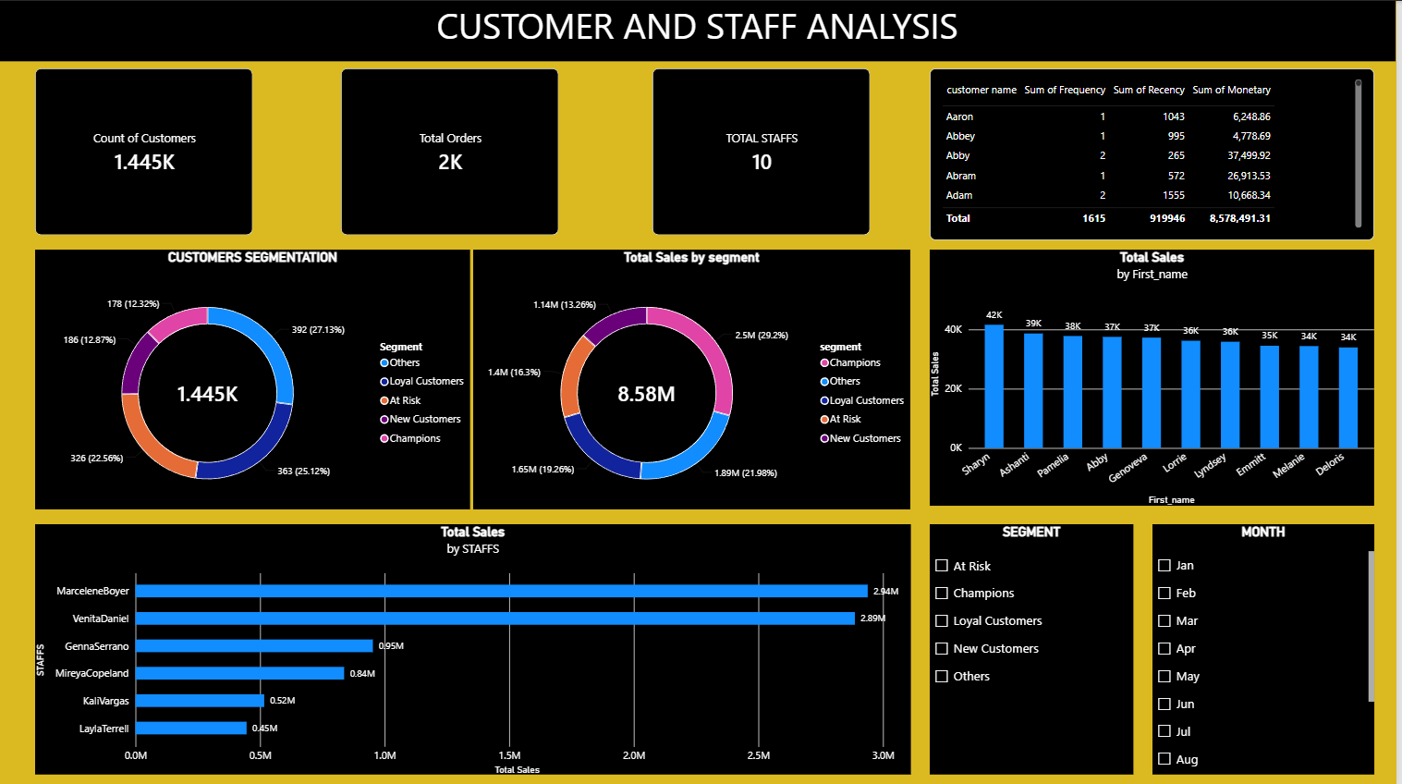
POWER BI • CUSTOMER & STAFF ANALYSIS
RFM segments • segment revenue • staff sales contribution • interactive filters

Slide 11


Key Insights & Business Interpretation
Turning analysis into decisions across four business areas
Sales
Inventory
Monitor total sales, monthly trends, store contribution and staff sales performance.
Monitor product/store stock records below the defined low-stock threshold.
Products
Customers
Identify highest-revenue and highest-sold products and review product/category performance.
Use RFM-based segments and geographic views to understand customer groups and their revenue contribution.
Current dashboard: 8.58M sales • 7K units • 2K orders • 1.82K average order value • 321 products
RETAIL SALES ANALYTICS | CAPSTONE PROJECT
8

Slide 12

Conclusion
What this capstone demonstrates
The project demonstrates an end-to-end data analytics workflow from structured retail data preparation to business intelligence reporting.
It combines Excel, MySQL, Python and Power BI concepts to transform transactional data into business-oriented views.
The final Power BI deliverable provides interactive reporting across Sales Performance, Inventory Insights and Customer Analysis.
The project provides a practical example of moving from raw business data to a management-ready dashboard.
Final deliverable: an interactive retail analytics workflow using Excel → MySQL → Python → Power BI.
RETAIL SALES ANALYTICS | CAPSTONE PROJECT
10

